Slide 1
Microservices and DevOps
Scalable Microservices
Logging
Henrik Bærbak Christensen

Slide 2
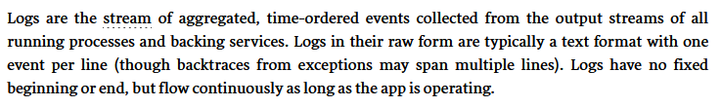
Logging
Definition
I.e. the source is the application itself
  Providing architectural and domain metrics
    If we do our log instrumentation of the application properly
12Factor recommendation
  Logs go to ‘stdout’, never attempt to manage log output yourself
  Docker’s recommendation is the same…
Notes:
From 12 factor. https://12factor.net/logs

Slide 3
Monitoring Requirements
Which boils down to three things
  That we have data – live and historic
    That is, our services must provide data
  That data provides the information that allows corrective action
    That is, our services must provide the right and relevant data
  And – that we can actually find/overview that required data
    That is, our services’ data is available, searchable, and meaningful
Notes:
From our Monitoring slides

Slide 4
Supporting Requirements
That we have data
  Logging framework Like SLF4J + Log4J
That logs have the information allowing corrective action
  Architectural/Design/Coding challenge
    log.error(“Bang!”); in 2.877 places in code is probably not good
    (And you only know what data you should have added in the log message, once you have your first failure☺)
That logs are searchable/provides meaningful overview
  Consistent choice of logging format is essential

Slide 5
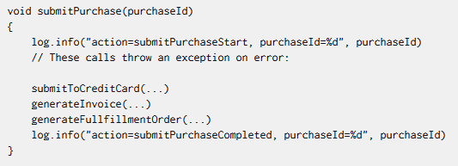
Logging Tactics
Best practices (Splunk)
  Use key-value pairs
  Human readable formats
    Binary is hell..
  Timestamp every event
    ISO 8601 ALWAYS ☺
  Use the unique IDs in the domain
    User id, transaction id, correlation id
  Log more than just ‘debugging’ events
    Application and Domain metrics
  Identify the source (traceability to source code)
    The method, class, thread, …

Slide 6
Logging Formats
Central tenet:
  Consistent format for log messages that can be easily parsed
Logs are for humans to read
  Or a log aggregation system to parse and visualize!
Serve two purposes
  Incident handling – find cause to allow corrective measures
  Overview of operations
The latter must be facilitated by queries in the log output
  Thus the format must be easy to parse…

Slide 7
Logging Formats
Common Log Format (CLF) – used by web servers
MongoDB
Windows Event Log, CEF, SysLog, …
Sigh…
https://www.graylog.org/post/log-formats-a-complete-guide
Notes:
https://www.graylog.org/post/log-formats-a-complete-guide

Slide 8
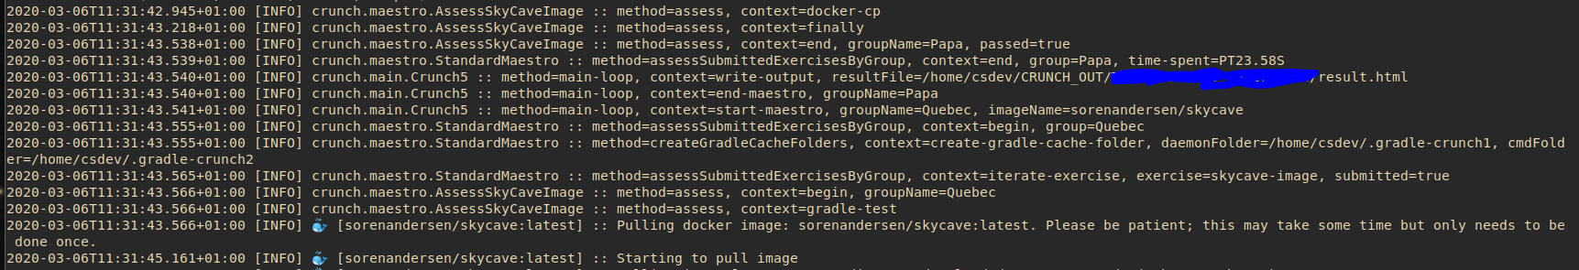
Key-value format
I like the idea of key-value, though a bit cumbersome to keep adhering to in code instrumentation…
  Parse friendly, but still relatively readable by me
Issue: 3rd party software drivers seldom agree on the
logging format, and that’s how MS systems are ☹

